Slide 1

Problem Solving Using Computer
Course Code: BCAC 0018
Lecture - 19
Course: BCA I Year I Semester
By: Mr. Shivank Chauhan
shivank.chauhan@gla.ac.in
+91-9694159338

Slide 2
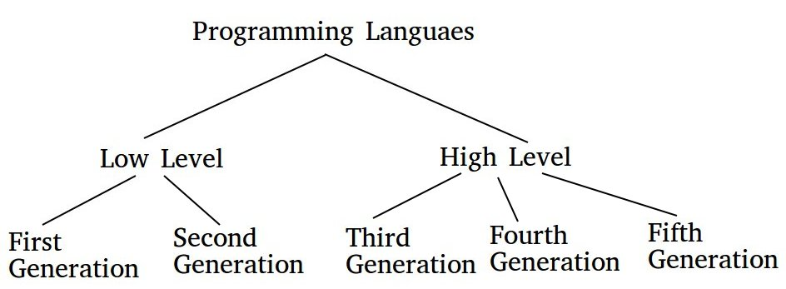
Generation of Programming Languages
There are five generations of Programming languages. They are:

Slide 3
First Generation
The first-generation languages are also called machine languages/ 1G language. This language is machine-dependent. The machine language statements are written in binary code (0/1 form) because the computer can understand only binary language.
Advantages :
1. Fast & efficient as statements are directly written in binary language.
2. No translator is required.
Disadvantages :
1. Difficult to learn binary codes.
2. Difficult to understand – both programs & where the error occurred.

Slide 4
Second Generation
The second-generation languages are also called assembler languages/ 2G languages. Assembly language contains human-readable notations that can be further converted to machine language using an assembler.
Advantages :
1. It is easier to understand if compared to machine language.
2. Modifications are easy.
3. Correction & location of errors are easy.
Disadvantages :
1. Assembler is required.
2. This language is architecture /machine-dependent, with a different instruction set for different machines.

Slide 5
Third Generation
The third generation is also called procedural language /3 GL. It consists of English-like words that humans can understand easily, to write instructions. It’s also called High-Level Programming Language. For execution, a program in this language needs to be translated into machine language using a Compiler/ Interpreter. Examples of this type of language are C, PASCAL, FORTRAN, COBOL, etc.
Advantages :
1. Use of English-like words makes it a human-understandable language.
2. Lesser number of lines of code as compared to the above 2 languages.
3. Same code can be copied to another machine.
Disadvantages :
1. Compiler/ interpreter is needed.
2. Different compilers are needed for different machines.

Slide 6
Fourth Generation
The fourth-generation language is also called a non – procedural language/ 4GL. It enables users to access the database. These languages are also human-friendly to understand.
Examples: SQL, Foxpro, Focus, Python etc.
Advantages :
1. Easy to understand & learn.
2. Less time is required for application creation.
3. It is less prone to errors.
Disadvantages :
1. Memory consumption is high.
2. Has poor control over Hardware.
3. Less flexible.

Slide 7
Fifth Generation
The fifth-generation languages are also called 5GL. It is based on the concept of artificial intelligence. It uses the concept that rather than solving a problem algorithmically, an application can be built to solve it based on some constraints, i.e., we make computers learn to solve any problem. Parallel Processing & superconductors are used for this type of language to make real artificial intelligence.
Examples: PROLOG, LISP, etc.
Advantages :
1. Machines can make decisions.
2. Programmer effort reduces to solve a problem.
3. Easier than 3GL or 4GL to learn and use.
Disadvantages :
1. Complex and long code.
2. More resources are required & they are expensive too.

